Slide 1
Notes:
All around us, particularly in nature and in the world of mathematics, we see strange and complex objects that cannot be really understood, measured or explained with conventional geometry.
This is the Mandelbrot set – an example of a fractal
Only recently, since the advent of modern computing, has the world of fractal geometry become open to us as a means to explain the shapes of these objects.
Self similar
Rivers, clouds, coastlines, mountains, plants, lightening, vegetation cover, snowflakes, animals and in their behavior, in our own bodies, archietecture and in the financial markets
Latst https://www.youtube.com/watch?v=ohzJV980PIQ
http://www.youtube.com/watch?v=n7JLHxBm0eY

Slide 2
Answers from HPC team
I can add you if you don’t have access – I just need your username
Do this once
module load anaconda3/personal
anaconda-setup
conda install r
conda install r-[packagename]
Do this in shell script
module load anaconda3/personal

Slide 3
Answers from HPC team continued
Ways to run R from terminal
R < $WORK/folder_name/code_file.R
R --vanilla < $WORK/folder_name/code_file.R
Rscript $WORK/folder_name/code_file.R
R CMD BATCH $WORK/folder_name/code_file.R
Please keep looking in DropBox for updated notes, I’ll put versions of the slides that are more like lecture notes there shortly.

Slide 4
C++ code for coalescence
See demo separately

Slide 5
Notes:
All around us, particularly in nature and in the world of mathematics, we see strange and complex objects that cannot be really understood, measured or explained with conventional geometry.
This is the Mandelbrot set – an example of a fractal
Only recently, since the advent of modern computing, has the world of fractal geometry become open to us as a means to explain the shapes of these objects.
Self similar
Rivers, clouds, coastlines, mountains, plants, lightening, vegetation cover, snowflakes, animals and in their behavior, in our own bodies, archietecture and in the financial markets
Latst https://www.youtube.com/watch?v=ohzJV980PIQ
http://www.youtube.com/watch?v=n7JLHxBm0eY

Slide 9
The Mandelbrot set

Slide 10
Complex numbers
1 × 1 = 1
-1 × 1 = -1
1 × -1 = -1

Slide 11
Complex numbers
1 × 1 = 1
-1 × 1 = -1
1 × -1 = -1
-1 × -1 = 1

Slide 12
Complex numbers
1 × 1 = 1
-1 × 1 = -1
1 × -1 = -1
-1 × -1 = 1
x
a
b
x×(a+b) = x×a + x×b

Slide 13
Complex numbers
1 × 1 = 1
-1 × 1 = -1
1 × -1 = -1
-1 × -1 = 1
x
a
b
x×(a+b) = x×a + x×b
-1×(3-2) = -1×3 + -1×-2

Slide 14
Complex numbers
1 × 1 = 1
-1 × 1 = -1
1 × -1 = -1
-1 × -1 = 1
x
a
b
x×(a+b) = x×a + x×b
-1×(3-2) = -1×3 + -1×-2 = -3 + -1×-2

Slide 15
Complex numbers
1 × 1 = 1
-1 × 1 = -1
1 × -1 = -1
-1 × -1 = 1
x
a
b
x×(a+b) = x×a + x×b
-1×(3-2) = -1×3 + -1×-2 = -3 + -1×-2
-1×(3-2) = -1×1 = -1

Slide 16
Complex numbers
1 × 1 = 1
-1 × 1 = -1
1 × -1 = -1
-1 × -1 = 1
x
a
b
x×(a+b) = x×a + x×b
-1×(3-2) = -1×3 + -1×-2 = -3 + -1×-2
-1×(3-2) = -1×1 = -1
-1 = -3 + -1×-2

Slide 17
Complex numbers
1 × 1 = 1
-1 × 1 = -1
1 × -1 = -1
-1 × -1 = 1
x
a
b
x×(a+b) = x×a + x×b
-1×(3-2) = -1×3 + -1×-2 = -3 + -1×-2
-1×(3-2) = -1×1 = -1
-1 = -3 + -1×-2
So 2 = -1×-2 

Slide 18
Complex numbers
1 × 1 = 1
-1 × 1 = -1
1 × -1 = -1
-1 × -1 = 1
x
a
b
x×(a+b) = x×a + x×b
-1×(3-2) = -1×3 + -1×-2 = -3 + -1×-2
-1×(3-2) = -1×1 = -1
-1 = -3 + -1×-2
So 2 = -1×-2 

Slide 19
The complex plane

Slide 20
The complex plane
Complex
X
b
Real
a

Slide 21
Complex
Real

Slide 22
Complex
r = 2
Real

Slide 23
The Mandelbrot set
Z Z² + C
C is given by your position on the complex plane

Slide 24
The Mandelbrot set
Z Z² + C
C is given by your position on the complex plane
Start with z = 0 and repeatedly apply the transformation

Slide 25
The Mandelbrot set
Z Z² + C
C is given by your position on the complex plane
Start with z = 0 and repeatedly apply the transformation
If the sequence of numbers that comes from this increases to infinity c is in the set, otherwise c is outside the set

Slide 27
(Filled in) Julia sets

Slide 28
(Filled in) Julia sets
Z Z² + C
C is a constant, every value of C gives a different Julia set
Start with z given by the position on the complex plane and repeatedly apply the transformation
If the sequence of numbers that comes from this increases to infinity c is in the set, otherwise c is outside the set
c = -0.738281 + 0.218750i
Notes:
Julia set is the boundary of the filled in julia set.

Slide 30
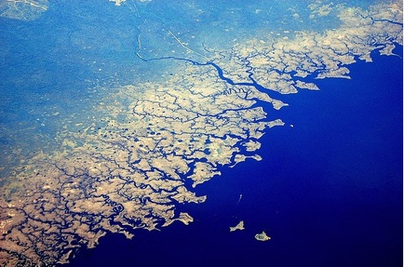

Slide 31
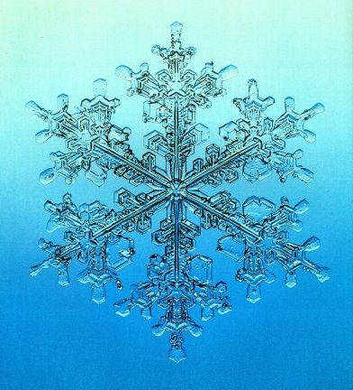

Slide 32
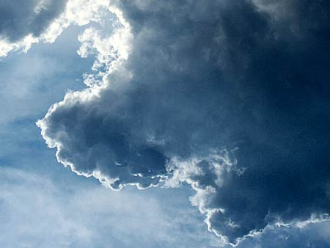

Slide 33
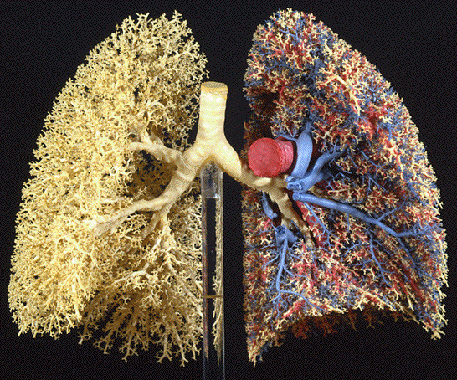

Slide 34
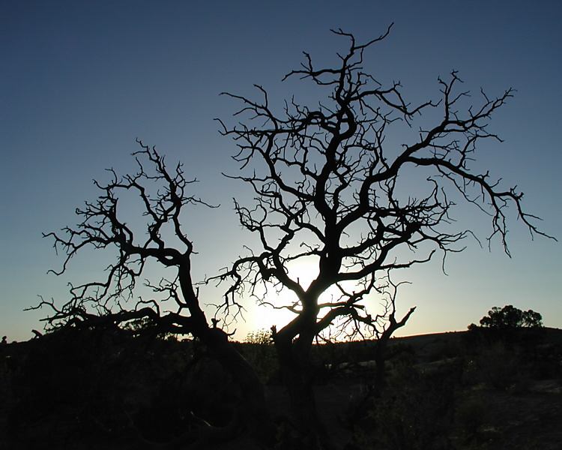
Notes:
http://www.google.co.uk/imgres?q=fractal%3B+tree&hl=en&gbv=2&biw=1280&bih=721&tbm=isch&tbnid=DzQM7_2E_RoCRM:&imgrefurl=http://www.pbase.com/rwalkernm/image/41202777&docid=lvezl3WCRgEX4M&imgurl=http://ic2.pbase.com/u32/rwalkernm/upload/41202777.FractalTree.jpg&w=750&h=600&ei=AGlbT_CAL4G_0QXA0dznCg&zoom=1&iact=hc&vpx=533&vpy=212&dur=945&hovh=201&hovw=251&tx=168&ty=138&sig=114573368585156778329&page=3&tbnh=161&tbnw=213&start=37&ndsp=20&ved=1t:429,r:12,s:37

Slide 35
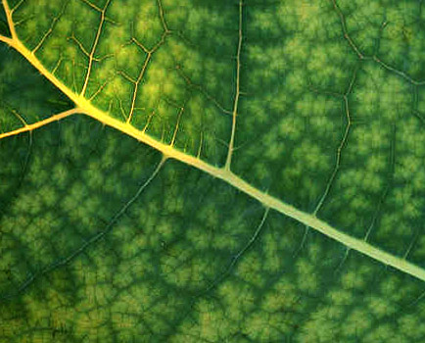

Slide 36
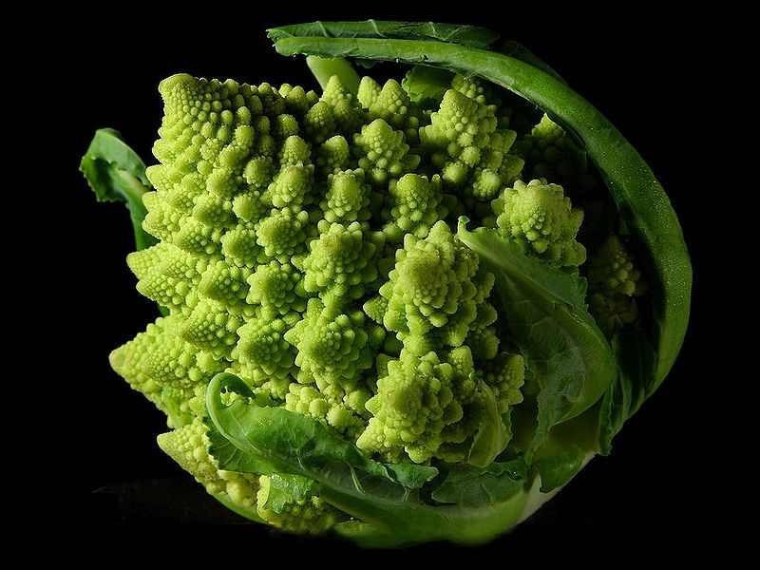

Slide 37
What is a fractal

Slide 38
What is not a fractal
A line twice as wide is twice as big
Dimension 1

Slide 39
What is not a fractal
A line twice as wide is twice as big
Dimension 1
Width
1
2
3
4
Size
1 = 1¹
2 = 2¹
3 = 3¹
4 = 4¹

Slide 40
What is not a fractal
A square twice as wide is four times as big
Dimension 2

Slide 41
What is not a fractal
A square twice as wide is four times as big
Dimension 2
Width
1
2
3
4
Size
1 = 1²
4 = 2²
9 = 3²
16 = 4²

Slide 42
What is not a fractal
A cube twice as wide is eight times as big
Dimension 3

Slide 43
What is not a fractal
A cube twice as wide is eight times as big
Dimension 3
Width
1
2
3
4
Size
1 = 1³
8 = 2³
27 = 3³
64 = 4³

Slide 44
What is a fractal

Slide 45
What is a fractal
Dimension that is not a whole number
Self similar

Slide 46
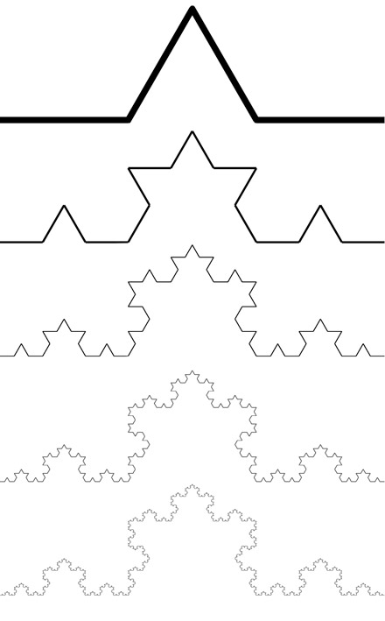
Koch Curve
Notes:
Miquel.com
Simplygreen.co.za
http://www.ibercivis.net/index.php?module=public&section=channels&action=view&id_channel=3&id_subchannel=133
http://therealsasha.files.wordpress.com/2011/10/snowflake-fractal.jpg
http://classes.yale.edu/fractals/panorama/Biology/Physiology/Physiology.html

Slide 47
Koch Curve
Notes:
Miquel.com
Simplygreen.co.za
http://www.ibercivis.net/index.php?module=public&section=channels&action=view&id_channel=3&id_subchannel=133
http://therealsasha.files.wordpress.com/2011/10/snowflake-fractal.jpg
http://classes.yale.edu/fractals/panorama/Biology/Physiology/Physiology.html

Slide 48
Koch Curve
Notes:
Miquel.com
Simplygreen.co.za
http://www.ibercivis.net/index.php?module=public&section=channels&action=view&id_channel=3&id_subchannel=133
http://therealsasha.files.wordpress.com/2011/10/snowflake-fractal.jpg
http://classes.yale.edu/fractals/panorama/Biology/Physiology/Physiology.html

Slide 49
Koch Curve
Notes:
Miquel.com
Simplygreen.co.za
http://www.ibercivis.net/index.php?module=public&section=channels&action=view&id_channel=3&id_subchannel=133
http://therealsasha.files.wordpress.com/2011/10/snowflake-fractal.jpg
http://classes.yale.edu/fractals/panorama/Biology/Physiology/Physiology.html

Slide 50
Koch Curve
Notes:
Miquel.com
Simplygreen.co.za
http://www.ibercivis.net/index.php?module=public&section=channels&action=view&id_channel=3&id_subchannel=133
http://therealsasha.files.wordpress.com/2011/10/snowflake-fractal.jpg
http://classes.yale.edu/fractals/panorama/Biology/Physiology/Physiology.html

Slide 51
Koch Curve
Notes:
Miquel.com
Simplygreen.co.za
http://www.ibercivis.net/index.php?module=public&section=channels&action=view&id_channel=3&id_subchannel=133
http://therealsasha.files.wordpress.com/2011/10/snowflake-fractal.jpg
http://classes.yale.edu/fractals/panorama/Biology/Physiology/Physiology.html

Slide 52
Koch Curve
Dimension
1
2
Width
3
3
Size
= 3¹
9 = 3²
Notes:
Miquel.com
Simplygreen.co.za
http://www.ibercivis.net/index.php?module=public&section=channels&action=view&id_channel=3&id_subchannel=133
http://therealsasha.files.wordpress.com/2011/10/snowflake-fractal.jpg
http://mthwww.uwc.edu/wwwmahes/mahes/index_000.htm
http://classes.yale.edu/fractals/panorama/Biology/Physiology/Physiology.html

Slide 53
Koch Curve
Dimension
1
2
Koch curve
Width
3
3
3
Size
= 3¹
9 = 3²
4
Notes:
Miquel.com
Simplygreen.co.za
http://www.ibercivis.net/index.php?module=public&section=channels&action=view&id_channel=3&id_subchannel=133
http://therealsasha.files.wordpress.com/2011/10/snowflake-fractal.jpg
http://mthwww.uwc.edu/wwwmahes/mahes/index_000.htm
http://classes.yale.edu/fractals/panorama/Biology/Physiology/Physiology.html

Slide 54
Koch Curve
Dimension
1
2
x
Width
3
3
3
Size
= 3¹
9 = 3²
4 = 3^{x}
Notes:
Miquel.com
Simplygreen.co.za
http://www.ibercivis.net/index.php?module=public&section=channels&action=view&id_channel=3&id_subchannel=133
http://therealsasha.files.wordpress.com/2011/10/snowflake-fractal.jpg
http://classes.yale.edu/fractals/panorama/Biology/Physiology/Physiology.html

Slide 55
Koch Curve
Dimension
1
2
x
Width
3
3
3
Size
= 3¹
9 = 3²
4 = 3^{x}
Notes:
Miquel.com
Simplygreen.co.za
http://www.ibercivis.net/index.php?module=public&section=channels&action=view&id_channel=3&id_subchannel=133
http://therealsasha.files.wordpress.com/2011/10/snowflake-fractal.jpg
http://classes.yale.edu/fractals/panorama/Biology/Physiology/Physiology.html

Slide 56
Koch Curve
Dimension
1
2
x
Width
3
3
3
Size
= 3¹
9 = 3²
4 = 3^{x}
Notes:
Miquel.com
Simplygreen.co.za
http://www.ibercivis.net/index.php?module=public&section=channels&action=view&id_channel=3&id_subchannel=133
http://therealsasha.files.wordpress.com/2011/10/snowflake-fractal.jpg
http://classes.yale.edu/fractals/panorama/Biology/Physiology/Physiology.html

Slide 57
Koch Curve
Dimension
1
2
x
Width
3
3
3
Size
= 3¹
9 = 3²
4 = 3^{x}
Notes:
Miquel.com
Simplygreen.co.za
http://www.ibercivis.net/index.php?module=public&section=channels&action=view&id_channel=3&id_subchannel=133
http://therealsasha.files.wordpress.com/2011/10/snowflake-fractal.jpg
http://classes.yale.edu/fractals/panorama/Biology/Physiology/Physiology.html

Slide 58
Koch Curve
Dimension
1
2
x
Width
3
3
3
Size
= 3¹
9 = 3²
4 = 3^{x}
Notes:
Miquel.com
Simplygreen.co.za
http://www.ibercivis.net/index.php?module=public&section=channels&action=view&id_channel=3&id_subchannel=133
http://therealsasha.files.wordpress.com/2011/10/snowflake-fractal.jpg
http://classes.yale.edu/fractals/panorama/Biology/Physiology/Physiology.html

Slide 59
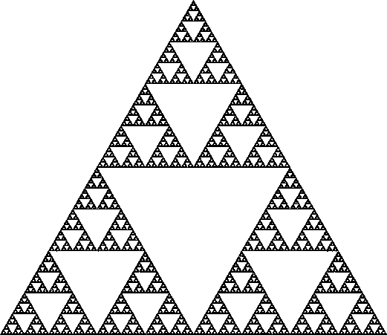
Sierpinski gasket

Slide 60
Sierpinski gasket

Slide 62
Measuring length and dimension:
the stick method

Slide 63
r

Slide 64
3

Slide 65
4

Slide 66
5

Slide 67
6

Slide 68
r
2π/2n
n
r sin (π/n)

Slide 69
Log (total length)
Log (length of side)
Notes:
Coastline length vs. Stick length

Slide 70
Log (total length)
Log (length of side)
Notes:
Coastline length vs. Stick length

Slide 71
Measuring dimension – stick method
3

Slide 72
Measuring dimension – stick method
7/2
=3.5

Slide 73
Measuring dimension – stick method
16/4
=4

Slide 74
Measuring dimension – stick method
35/8
=4.38

Slide 75
The dimension of various coastlines

Slide 76
Fractal dimension D = 1 - gradient
Log (total length)
Intercept gives
an idea of size
Log (length of stick)
Notes:
Trunk diameter – means something different for different sizes of organisms

Slide 77
The dimension of various coastlines
D = 1.18 for this example
D = 1.25 for the west coast of Britain,
D = 1.15 for the land frontier of Germany,
D = 1.14 for the land frontier of Portugal,
D = 1.13 for the Australian coast, and
D = 1.02 for the South African coast,

Slide 78
The dimension of various coastlines
D = 1.18 for this example
D = 1.25 for the west coast of Britain,
D = 1.15 for the land frontier of Germany,
D = 1.14 for the land frontier of Portugal,
D = 1.13 for the Australian coast, and
D = 1.02 for the South African coast,

Slide 79
The stick method formalized
Total length (stick length)
Dimension
Constant
Stick length
Notes:
It’s in the limit of delta -> 0
Think about what happens when D = 1

Slide 80
The stick method formalized
Total length (stick length)
Dimension
Constant
Stick length
intercept
gradient

Slide 81
Fractal dimension D = 1 - gradient
Log (total length)
Intercept gives
an idea of size
Log (length of stick)
Notes:
Trunk diameter – means something different for different sizes of organisms

Slide 82
Log (total length)
Log (length of stick)

Slide 83
Non fractal behavior
Fractal behavior
Non fractal behavior
Log (total length)
Log (length of stick)
Halley et al.
Notes:
Or different fractal dimensions at different scales

Slide 84
Non fractal behavior
Fractal behavior A
Fractal behavior B
Log (total length)
Log (length of stick)
Notes:
Or different fractal dimensions at different scales
Talk about a ball on a string

Slide 85
Koch Curve
1
Notes:
Miquel.com
Simplygreen.co.za
http://www.ibercivis.net/index.php?module=public&section=channels&action=view&id_channel=3&id_subchannel=133
http://therealsasha.files.wordpress.com/2011/10/snowflake-fractal.jpg
http://mthwww.uwc.edu/wwwmahes/mahes/index_000.htm
http://classes.yale.edu/fractals/panorama/Biology/Physiology/Physiology.html

Slide 86
Koch Curve
1
Stick size
1
Length
1
Notes:
Miquel.com
Simplygreen.co.za
http://www.ibercivis.net/index.php?module=public&section=channels&action=view&id_channel=3&id_subchannel=133
http://therealsasha.files.wordpress.com/2011/10/snowflake-fractal.jpg
http://mthwww.uwc.edu/wwwmahes/mahes/index_000.htm
http://classes.yale.edu/fractals/panorama/Biology/Physiology/Physiology.html

Slide 87
Koch Curve
1
Stick size
1
1/3
Length
1
4 × 1/3
Notes:
Miquel.com
Simplygreen.co.za
http://www.ibercivis.net/index.php?module=public&section=channels&action=view&id_channel=3&id_subchannel=133
http://therealsasha.files.wordpress.com/2011/10/snowflake-fractal.jpg
http://mthwww.uwc.edu/wwwmahes/mahes/index_000.htm
http://classes.yale.edu/fractals/panorama/Biology/Physiology/Physiology.html

Slide 88
Koch Curve
1
Stick size
1
1/3
1/9
Length
1
4 × 1/3
16 × 1/9
Notes:
Miquel.com
Simplygreen.co.za
http://www.ibercivis.net/index.php?module=public&section=channels&action=view&id_channel=3&id_subchannel=133
http://therealsasha.files.wordpress.com/2011/10/snowflake-fractal.jpg
http://mthwww.uwc.edu/wwwmahes/mahes/index_000.htm
http://classes.yale.edu/fractals/panorama/Biology/Physiology/Physiology.html

Slide 89
Koch Curve
1
Stick size
1
1/3
1/9
1/27
Length
1
4 × 1/3
16 × 1/9
64 × 1/27
Notes:
Miquel.com
Simplygreen.co.za
http://www.ibercivis.net/index.php?module=public&section=channels&action=view&id_channel=3&id_subchannel=133
http://therealsasha.files.wordpress.com/2011/10/snowflake-fractal.jpg
http://mthwww.uwc.edu/wwwmahes/mahes/index_000.htm
http://classes.yale.edu/fractals/panorama/Biology/Physiology/Physiology.html

Slide 90
Koch Curve
1
Stick size
1
1/3
1/9
1/27
3^{-n}
Length
1
4 × 1/3
16 × 1/9
64 × 1/27
4^{n} × 3^{-n}
Notes:
Miquel.com
Simplygreen.co.za
http://www.ibercivis.net/index.php?module=public&section=channels&action=view&id_channel=3&id_subchannel=133
http://therealsasha.files.wordpress.com/2011/10/snowflake-fractal.jpg
http://mthwww.uwc.edu/wwwmahes/mahes/index_000.htm
http://classes.yale.edu/fractals/panorama/Biology/Physiology/Physiology.html

Slide 91
Koch Curve
1
Stick size
1
1/3
1/9
1/27
3^{-n}
Length
1
4 × 1/3
16 × 1/9
64 × 1/27
4^{n} × 3^{-n}
Notes:
Miquel.com
Simplygreen.co.za
http://www.ibercivis.net/index.php?module=public&section=channels&action=view&id_channel=3&id_subchannel=133
http://therealsasha.files.wordpress.com/2011/10/snowflake-fractal.jpg
http://mthwww.uwc.edu/wwwmahes/mahes/index_000.htm
http://classes.yale.edu/fractals/panorama/Biology/Physiology/Physiology.html

Slide 92
Koch Curve
1
Stick size
1
1/3
1/9
1/27
3^{-n}
Length
1
4 × 1/3
16 × 1/9
64 × 1/27
4^{n} × 3^{-n}
Notes:
Miquel.com
Simplygreen.co.za
http://www.ibercivis.net/index.php?module=public&section=channels&action=view&id_channel=3&id_subchannel=133
http://therealsasha.files.wordpress.com/2011/10/snowflake-fractal.jpg
http://mthwww.uwc.edu/wwwmahes/mahes/index_000.htm
http://classes.yale.edu/fractals/panorama/Biology/Physiology/Physiology.html

Slide 93
Koch Curve
1
Stick size
1
1/3
1/9
1/27
3^{-n}
Length
1
4 × 1/3
16 × 1/9
64 × 1/27
4^{n} × 3^{-n}
Notes:
Miquel.com
Simplygreen.co.za
http://www.ibercivis.net/index.php?module=public&section=channels&action=view&id_channel=3&id_subchannel=133
http://therealsasha.files.wordpress.com/2011/10/snowflake-fractal.jpg
http://mthwww.uwc.edu/wwwmahes/mahes/index_000.htm
http://classes.yale.edu/fractals/panorama/Biology/Physiology/Physiology.html

Slide 94
Koch Curve
1
Stick size
1
1/3
1/9
1/27
3^{-n}
Length
1
4 × 1/3
16 × 1/9
64 × 1/27
4^{n} × 3^{-n}
Notes:
Miquel.com
Simplygreen.co.za
http://www.ibercivis.net/index.php?module=public&section=channels&action=view&id_channel=3&id_subchannel=133
http://therealsasha.files.wordpress.com/2011/10/snowflake-fractal.jpg
http://mthwww.uwc.edu/wwwmahes/mahes/index_000.htm
http://classes.yale.edu/fractals/panorama/Biology/Physiology/Physiology.html

Slide 95
Koch Curve
3
Stick size
3
1
1/3
1/9
3^{(1-n)}
Length
3
4 × 1
16 × 1/3
64 × 1/9
4^{n} × 3^{(1-n)}
Notes:
Miquel.com
Simplygreen.co.za
http://www.ibercivis.net/index.php?module=public&section=channels&action=view&id_channel=3&id_subchannel=133
http://therealsasha.files.wordpress.com/2011/10/snowflake-fractal.jpg
http://mthwww.uwc.edu/wwwmahes/mahes/index_000.htm
http://classes.yale.edu/fractals/panorama/Biology/Physiology/Physiology.html

Slide 97
Box counting algorithm
Box length 1
Number boxes 6

Slide 98
Box counting algorithm
Box length 1/2

Slide 99
Box counting algorithm
Box length 1/2
Number boxes 20

Slide 100
Box counting algorithm
Box length 1/8
Number boxes 67

Slide 101
Box counting algorithm
 |  |  |  |  | 7
Box length 1/16
Number boxes 238
Notes:
Mention more complex methods that allow gray scales and even look at the boundaries of the object

Slide 102
Box counting algorithm
Fractal dimension D = -1 × gradient
Log (N)
N = number of squares needed to cover the object
Intercept gives
an idea of size
Log (length of square)

Slide 103
In our example
Fern D = 1.767

Slide 104
Box counting algorithm
Fractal dimension D = -1 × gradient
Log (N)
N = number of hypercubes needed to cover the object
Intercept gives
an idea of size
Log (length of hypercube)

Slide 105
The box counting algorithm formalized
number of hypercubes needed to cover the object
Dimension
Constant
Hypercube length

Slide 106
The box counting algorithm formalized
number of hypercubes needed to cover the object
Dimension
Constant
Hypercube length
intercept
gradient

Slide 107
Comparing box and stick methods
number of hypercubes needed to cover the object
Dimension
Constant
Hypercube length

Slide 108
Comparing box and stick methods
number of sticks needed to go round the perimeter
Dimension
Constant
Stick length

Slide 109
Comparing box and stick methods
number of sticks needed to go round the perimeter
Dimension
Constant
Stick length
Total length
Dimension
Constant
Stick length

Slide 110
Hausdorff dimension
The hausdorff dimension d of an object has the property that the number of balls of radius r needed to cover the object grows proportionally to r^{-d} as r becomes small
(Alexis Monnerot-Dumaine)
Notes:
Alexis Monnerot-Dumaine

Slide 111
Hausdorff dimension
Balls of radius r_{i} > 0 can cover the object
(Alexis Monnerot-Dumaine)
Notes:
Alexis Monnerot-Dumaine

Slide 112
Why do fractals appear in nature?

Slide 113
Why do fractals appear in nature?
In organisms
A simple set of rules (DNA)
Fractal structures are heritable
Need to maximize surface area but minimize volume
Efficiency of transportation
(Bailey et al. 2004)
Notes:
Kidney, circulatory system, lungs, brain
If something is made it is much harder to be fractal – though at some scale it will be because of mistakes and errors
Fractals have to grow or appear as a result of properties that are the same at multiple scales

Slide 114
Why do fractals appear in nature?
In geography
Same processes at multiple scales
Notes:
Kidney, circulatory system, lungs, brain
If something is made made is much harder to be fractal – though at some scale it will be because of mistakes and errors
Fractals have to grow or appear as a result of properties that are the same at multiple scales

Slide 115
Why do fractals appear in nature?
In geography
Same processes at multiple scales
In landscape ecology
In animal behavior
Chaos
Wait for the next lecture
Notes:
Kidney, circulatory system, lungs, brain
If something is made made is much harder to be fractal – though at some scale it will be because of mistakes and errors
Fractals have to grow or appear as a result of properties that are the same at multiple scales

